Slide 1
CRIME RECORD MANAGEMENT SYSTEM GROUP 1

Slide 2
MEMBERS
Lordwell Manondo bed-com-26-18
Chifuniro Masula bed-com-19-18
Molece Nkhoma esc-37-16
Yamikani Chabuka bed-com-42-18
William Chikaoneka bed-com-22-18

Slide 3
PROBLEM STATEMENT
It is obviously believed that the police force is charged with the responsibility of protecting lives, property and assuring safety and well-being of all citizens through the detection and apprehension of criminals, prevention and control of crime. Nevertheless, there are still some shortcomings: Poor criminal record keeping in short and long-term bases which makes the processing difficult. Delayed feedback on the investigated crime cases. High cost of saving crime data as it is mostly associated with paperwork. Frequent cases of missing files/documents because records are not properly secure.

Slide 4
Focus
To design and develop an application that will help to improve the efficiency and effectiveness of the police security measures in keeping criminal records and assign the necessary police officer to investigate the crime and provide a report in time and at low cost.

Slide 5
Functional requirements
System should allow
1. Admin to:
Login
Change credentials
Record case
Check cases (both in the system or just reported)
Assign work to police officers
View Public users
Notified of messages sent by general public
View notifications
Share data with relevant authorities
Add users(officers)
Notify officers of the duty assigned to

Slide 6
Functional requirements cont…
2. user(officers) to:
Log in
Change credentials(password)
Receive notification of the assigned work
View notifications
Report findings of assigned work
Report incident

Slide 7
Functional requirements cont…
3. User (general public) to:
Register
Log in
Change password
Report case

Slide 8
Non functional requirements
System should be
Effective
Efficient
Secure
User friendly

Slide 9
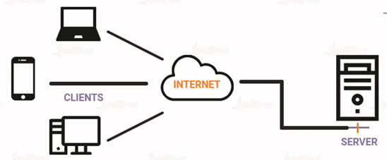
System architecture(client-server)
Officer
Public user
Admin

Slide 10
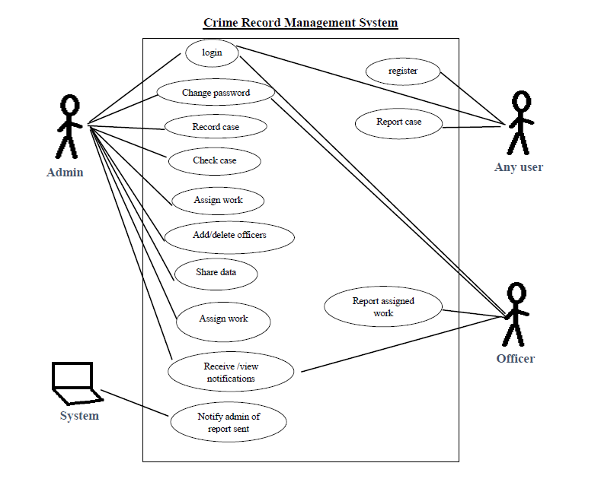
Use case
<<
>>

Slide 11
DEVELOPMENT TOOLS
Figma for prototype
Xampp for Database management
Bootstrap framework
CSS and HTML
PHP for backend

Slide 12
SYSTEM DEMONSTRATION

